Slide 1


Unearthed Innovation Project
Riona
Natural dyes
Rising Stars
(Riona, Shaivi, Zoey, Saanvi, Saumya, Girisha, Riya)
Notes:
Riona

Slide 2
Identify / Problem Selection
Riona
Ideas Explored
Robotic Arm in Field of Archaeology
LIDAR / SONAR
Natural Cooling / Wind Tower
Artificial Dyes in Jewelry
Artificial Dyes in Food
Notes:
Riona

Slide 3

Identify / Problem Details
Shaivi
Artificial dyes cause lots of pollution
Water pollution
Soil pollution
Air pollution
The pollution that comes from artificial dyes can cause health issues
Cancer
Behavior issues
DNA damage
Allergic reactions
Artificial dyes also affect Wildlife and Aquatic life
Civilization moved away from natural dyes because of cost, consistency, and availability of natural ingredients
Notes:
Shaivi

Slide 4
Design / Solution
Zoey
Replace use of artificial dyes with natural dyes
Solve the problem using Artificial Intelligence (AI)
Control mass production using AI color detection
Maintain color consistency using AI color detection
Notes:
Shaivi

Slide 5
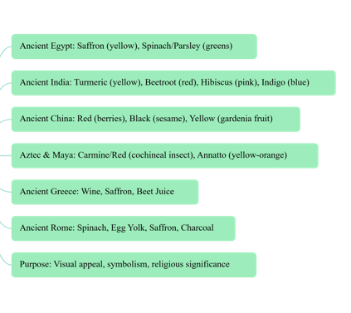
Create / Summary
Zoey
We researched about how different civilizations used natural dyes in their life style
Ancient civilizations used different methods to dye stuff such as
Boiling plants to turn them into dyes
Crushing the plants to make dyes
Rubbing the plants/rocks to turn them into dyes
Notes:
Zoey

Slide 6
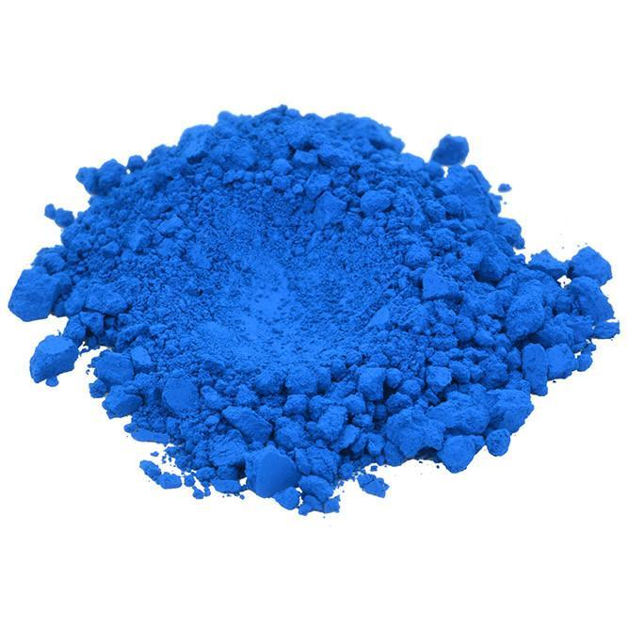
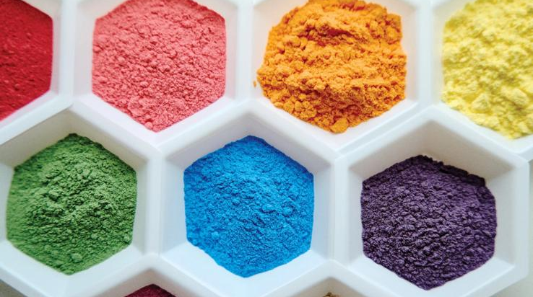
Create/ Egyptian Civilization
Saanvi
Artificial Dye
Blue 1
Egyptian women crushed lapis lazuli
Heating a mixture of crushed limestone, sand, and copper-bearing minerals like azurite or malachite to make a blue color
Notes:
Zoey

Slide 7
Create/ Indus River Valley Civilization
Saanvi
Artificial Dye
Yellow 5
Used turmeric to create yellow dye
Turmeric rhizomes were dug up, cleaned, boiled, and dried and crushed the cleaned Turmeric
The fabric would then be soaked in the dye bath, allowing the color to absorb into the fibers
Notes:
Saanvi

Slide 8
Create/ Chinese Civilization
Saumya
Artificial Dye
Green 3
Crushed matcha leaves to make green powder
Notes:
Saanvi

Slide 9
Create/ Aztec & Maya Civilization
Saumya
Artificial Dye
Red 40
In the Maya civilization they used cochineal insects and hematite to create a vibrant red color
Notes:
Saumya

Slide 10
Create/ Greece Civilization
Girisha
Artificial Dye
Reed 40 + Blue 1
People in Greece the mucus glands of specific sea snails, primarily the spiny dye-murex (Murex brandaris) to a purple color
Notes:
Saumya

Slide 11
Create/ AI Model
Girisha
Color detection
MIT App Inventor
Sample
Camera
/
Sensor
Android Phone
Laptop Camera
ML4K AI Model
AI Model
Training Data
ML4K is Machine Learning for Kids
Notes:
Girisha

Slide 12
Iterate/ AI Model
Riya
Trained the model
By giving it 10 or more samples for each color
Adjusted the model as we went on
Reviewed the results and trained the model further
Notes:
Girisha

Slide 13
Communicate
Riya
Result, Learning and Outcome
Natural dyes are better for everyone’s health and the environment
AI can help to keep consistency with the manufacturing of the colors using natural resources or ingredients
Team is working on creating a Functional App to raise awareness
Recommendation (hand out samples)
Switch to start using natural dyes
Notes:
Riya

Slide 14
Thank you!
Riya
Notes:
Riya

Slide 15
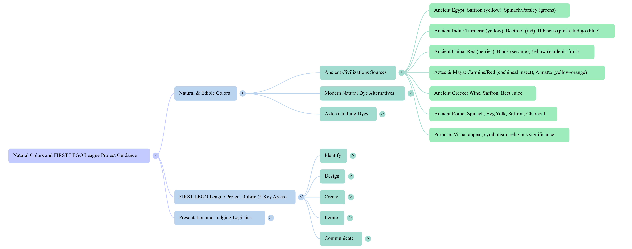

Slide 16
Civilizations Researched
Create / Summary

